Slide 1
Real-time Hand Gesture Recognition using TensorFlow & OpenCV
Submitted in the partial fulfillment for the award of the degree of
BACHELOR OF ENGINEERING
IN
ARTIFICIAL INTELLIGENCE AND MACHINE LEARNING
Submitted by:
KOPPULA PRAKASH – 21BCS8824
T. BHAGEERATH – 20BCS6380
M.L.K.SUBRAHMANYAM – 21BCS8803
ENDLURU VIGNESH - 20BCS6891
Under the Supervision of:
MRS. SHWETA THAKUR
Department of AIT-CSE
DISCOVER . LEARN . EMPOWER

Slide 2
Outline
Introduction to Project
Problem Formulation
Objectives of the work
Methodology used
Results and Outputs
Conclusion
Future Scope
References

Slide 3
Introduction
The majority of deaf-and-mute people use sign language produced by body actions such as hand gestures, body motion, eyes and facial expressions to communicate amongst each other and with non- impaired people in their daily life.
However it has become a barrier for mute and deaf communities which intend to integrate into society. Therefore, it is significant to have a medium that can recognize and translate gesture into understandable words by common people, as the information carried by hand gestures is always principal in sign language.
To bridge the communication gap, a hand gesture system for Sign Language Recognition (SLR) is required.

Slide 4
Gesture Recognition
Gesture recognition is an active research field in Human-Computer Interaction technology.
Gesture provides a way for computers to understand human body language.
Deals with the goal of interpreting human gestures via mathematical algorithms.
Enables humans to interface with the machine (HMI) and interact naturally without any mechanical devices.

Slide 5
Problem Formulation
The challenge is to create a system capable of accurately recognizing hand gestures in real-time environments.
Develop a computer vision-based system using TensorFlow and OpenCV to recognize hand gestures in real-time.
Utilize OpenCV for real-time video processing, hand detection, and gesture tracking.
Enhance safety and efficiency in interactive applications by accurately detecting and interpreting hand gestures.
Enable gesture-based control in devices and interfaces to provide users with intuitive and seamless interaction experiences.

Slide 6
Objectives of the Work
This project aims to design a real-time vision-based hand gesture recognition system with machine learning techniques which potentially makes deaf-and-mute people life easier.
Making the system more efficient than the previous existing system and improving the accuracy.
Customizing the system considering various real life situations.

Slide 7
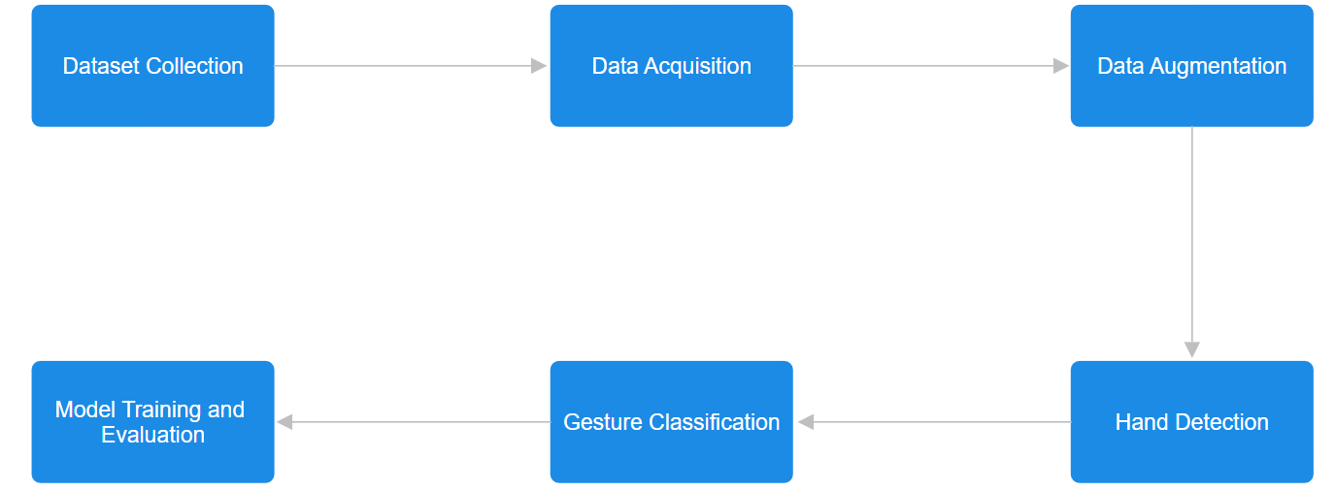
Preliminary Design of the project
Fig. 1. Design of the Project

Slide 8
Preliminary Design of the project
Dataset Collection: Dataset is the input for the model to train which is collected from various resources.
Data Acquisition: Data Acquisition is the process of collecting, processing, storing and structuring the raw data.
Data Augmentation: Data Augmentation is a process where set of techniques like rotations, translations, flips, adjustments are operated on images.
Hand Detection: Hand is detected in real time through a camera for the model to recognize the gesture.
Gesture Classification: Gestures, that are detected, will be classified into various labelled classes accordingly.
Model Training and Evaluation: Model is trained from the collected dataset with different classes followed by how well is it classifying the gestures.

Slide 9
Methodology
Dataset Collection:
Dataset contains collection of images required for model training to classify the gestures
The images are collected through various means like capturing images from real time camera for training.

Slide 10
Data Acquisition:
Video frames are continuously captured from a camera feed using OpenCV, ensuring a steady stream of input data for hand gesture recognition.
This process involves accessing the video feed from a webcam or another device, converting each frame into a format compatible with the subsequent processing steps, and organizing the data for efficient handling.

Slide 11
Data Augmentation:
In order to enhance the diversity of the training dataset, we implemented data augmentation methodologies.
These augmentations encompass random operations such as flips, translations, rotations, and adjustments to brightness. This augmentation strategy serves to bolster the model's robustness against variations in the input data.

Slide 12
Hand Detection:
The utilization of pre-trained deep learning models, regions of interest containing hands are localized, typically delineated by bounding boxes.
This step forms the foundation for subsequent landmark detection and gesture recognition processes. The convolutional layers handle the input images as two-dimensional matrices.

Slide 13
Gesture Classification:
The KeyPointClassifier identifies static hand gestures, while the PointHistoryClassifier focuses on dynamic finger gestures by analyzing movement histories.
These classifiers, often implemented using machine learning techniques, enable the system to accurately recognize a wide range of gestures in real-time scenarios.

Slide 14
Model Training and Evaluation:
Training involves iterative refinement of model parameters using gradient-based optimization algorithms, with evaluation metrics such as accuracy and F1 score providing insights into the model's effectiveness.
By iteratively fine-tuning the model, the system ensures robust performance across diverse hand gestures.

Slide 15
Analysis of features ( including updates for the project )
The principal components encompassed within the gesture recognition project comprise the following features:
Hi, hello
Super
Please
Thank you
I love you
Note: In this project customized hand gestures can be added accordingly.

Slide 16
Feature/characteristics Identification
Robustness
Dynamic Gesture Recognition
Multi-Gesture Recognition
Finger Tracking
Real-time Processing

Slide 17
Constraint Identification
Limited Gesture Vocabulary
Large Training Dataset Requirement
Extended Training Time
Optimization Strategies
Data Augmentation
Transfer Learning
Model Pruning

Slide 18
Analysis of Features and Finalization Subject to Constraints
Limited Gesture Vocabulary:
Conducted thorough user research and task analysis to identify the most essential gestures for the intended use case. Finalize a set of 10 gestures that cover a wide range of interactions while considering user preferences and application requirements.
Large Training Dataset Requirement
Optimize data collection strategies by focusing on capturing diverse samples that effectively represent the variability in hand gestures. Utilize data augmentation techniques to augment the dataset size without additional manual collection. Prioritize quality over quantity to maximize the effectiveness of training.
Extended Training Time
Employ strategies to reduce training time, such as utilizing high-performance GPUs or cloud computing resources. Implement optimization techniques like transfer learning and model pruning to expedite the training process. Prioritize efficiency in model architecture and training algorithms to minimize computational overhead.

Slide 19
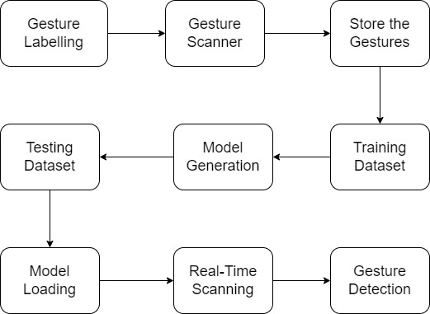
Design Selection

Slide 20
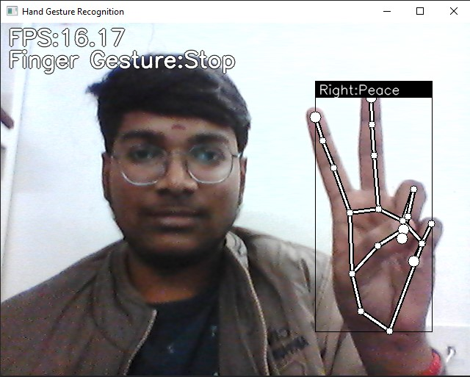
Results
Fig. 2. Recognition of Peace Sign

Slide 21
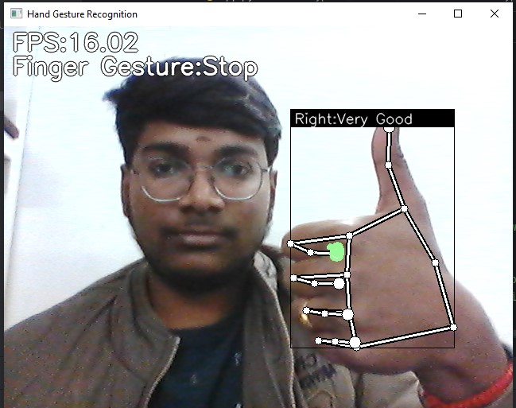
Results
Fig. 3. Recognition of Very Good Sign

Slide 22
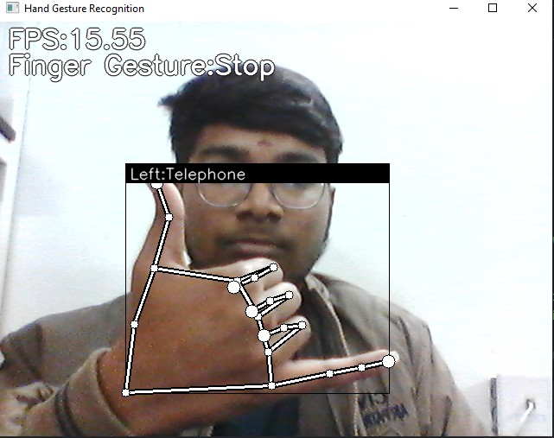
Results
Fig. 4. Recognition of Telephone Sign

Slide 23
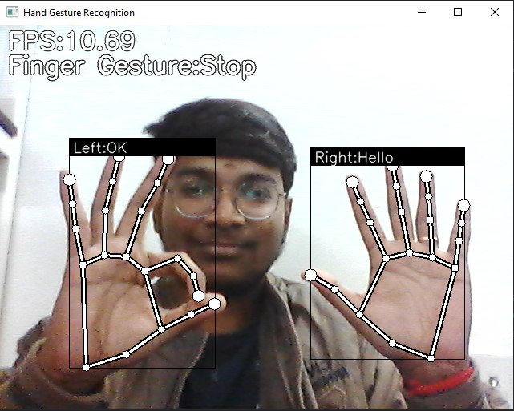
Results
Fig. 5. Recognition of OK and Hello signs from both hands

Slide 24
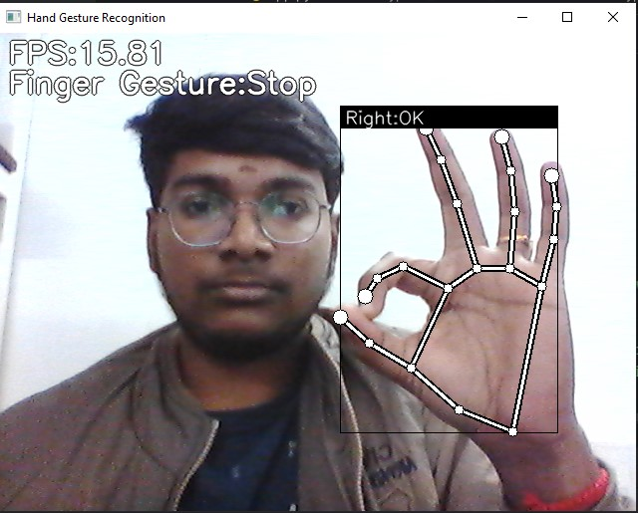
Results
Fig. 6. Recognition of OK Sign

Slide 25
Conclusion
Research focuses on developing a hand gesture recognition system for improved human-computer interaction.
Computer vision-based solution shows promise in accurately identifying and interpreting hand gestures in real-time.
Challenges like rapid motion require further refinement, but the system holds potential for revolutionizing user interfaces in gaming, augmented reality, and assistive technologies.

Slide 26
Future Scope
Integration with AR/VR: Enable users to control virtual objects or navigate environments through hand gestures in augmented and virtual reality systems.
Assistive Technologies: Empower individuals with disabilities by recognizing sign language gestures for communication and designing accessible interfaces.
Healthcare Applications: Implement touchless interaction in medical settings for controlling equipment and facilitating telemedicine consultations.
Smart Home Control: Enable gesture-based commands for managing devices and appliances in smart home systems, enhancing convenience and energy efficiency.
Human-Robot Interaction: Improve communication and collaboration between humans and robots by enabling gesture-based programming and safety interactions.

Slide 27
References
[1] Yang, J., Nguyen, M. N., San, P. P., & Li, X. (2018). Hand gesture recognition for human-computer interaction: A review. Journal of Visual Communication and Image Representation, 59, 43-60.
[2] Cao, Z., Simon, T., Wei, S. E., & Sheikh, Y. (2017). Realtime multi-person 2d pose estimation using part affinity fields. In Proceedings of the IEEE Conference on Computer Vision and Pattern Recognition (pp. 7291-7299).
[3] Tompson, J., Jain, A., LeCun, Y., & Bregler, C. (2014). Joint training of a convolutional network and a graphical model for human pose estimation. In Advances in Neural Information Processing Systems (pp. 1799-1807).
[4] Pu, J., Wu, T. F., & Li, L. (2020). Real-time hand gesture recognition using convolutional neural networks. IEEE Access, 8, 102292-102306.
[5] Sarkar, S., & Ghosh, M. (2018). A survey on hand gesture recognition techniques. Journal of Intelligent Information Systems, 51(3), 413-450.

